Slide 1
Dipartimento di Scienze Biomolecolari, Genomiche e Cellulari
Evaluation of COMP (Cartilage Oligomeric Matrix Protein) as marker enhancement in different tumor types through the use of monoclonal antibodies
Laureando
Cristofaro Debora
Relatore
Prof. Perris Roberto
Correlatore
Dott.ssa Boiardi Erika

Slide 2
COMP (Cartilage Oligomeric Matrix Protein)
Binding with extracellular proteases
COMP is a calcium-binding ECM glycoprotein, belonging to the Thrombospondin family
Molecular weight of 524 kDa
Binding with ECM proteins
Binding with calcium ions
Responsible of pentamerisation
NTD
1
2
3
4
T1
T2
T3
T4
T5
T6
T7
T8
CTD
N-terminal
domain
EGF-like domain
TSP-type III domain
C-terminal domain

Slide 3
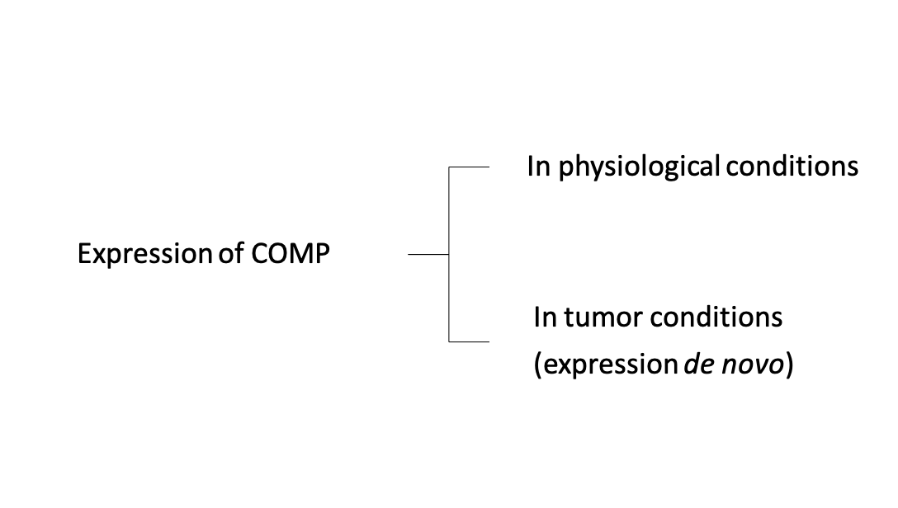
COMP as a tumor marker
Cartilage, bone and connective tissue
Pancreatic carcinoma
Colorectal carcinoma
Hepatocellular carcinoma
Prostate carcinoma
Breast carcinoma
Poor prognosis and increased metastasis, associated with increased COMP in patients' serum levels
Increased cell proliferation
Increased resistance to apoptosis
Increased resistance to ER stress

Slide 4
Development and characterization of monoclonal antibodies directed against COMP
Valuation of possible use for diagnostic and/or therapeutic use
Identification of sarcoma lines constitutively expressing the protein
Aim of study

Slide 5
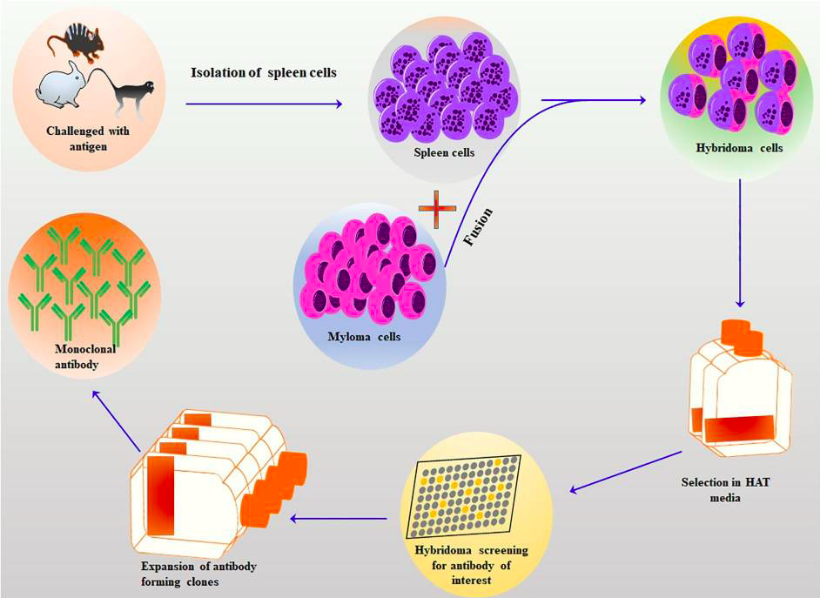
Hybridoma technology
Immunization of mice/rats with COMP extracted from healthy human cartilage (whole and fragmented)
mAb 1
mAb 2
mAb 3
mAb 4
mAb 5
mouse
mAb 6
mAb 7
mAb 8
mAb 9
rat

Slide 6
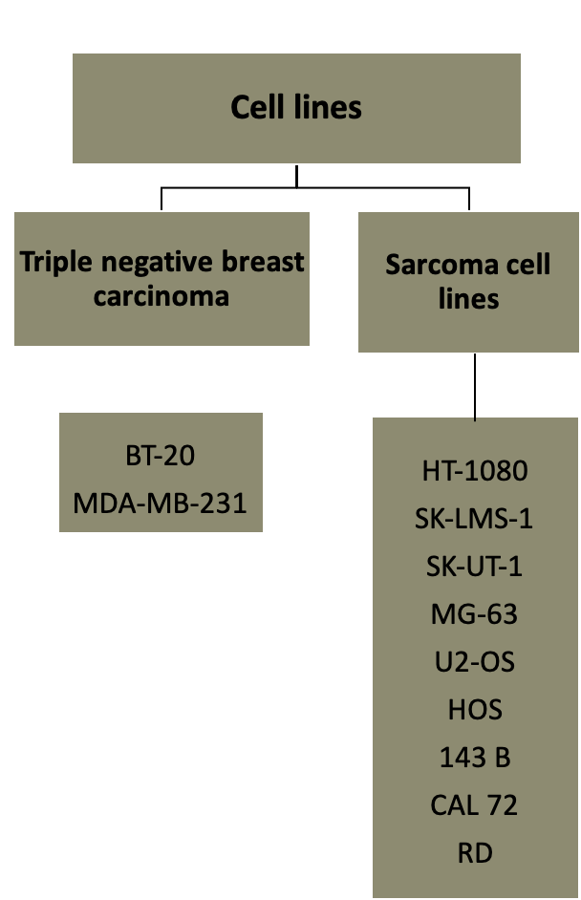
Western Blotting | Evaluate the ability of mAbs to recognize and bind COMP
Immunocytochemistry | Evaluate the intra/extra-cellular localization of COMP
Flow cytometry | Quantifying intra/extra-cellular COMP levels
Scrath Assay | Evaluate the influence of mAbs on cell migration and possible interaction with ECM proteins
Cell Death Assay | Evaluate cell death induced by mAb and mAb-chemotherapy drug combination

Slide 7
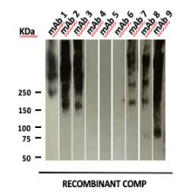
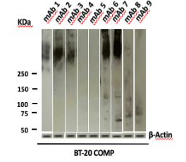
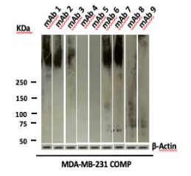
Western Blotting
Non-reducing conditions
Binding of the various purified mAbs to:
Recombinant COMP extracted from healthy human cartilage
COMP expressed by transfected tumor cells
Reducing conditions

Slide 8
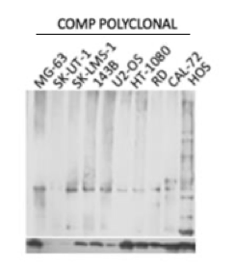
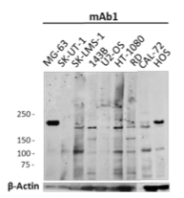
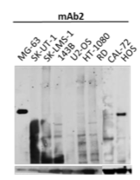
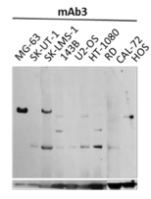
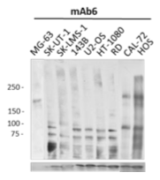
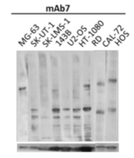
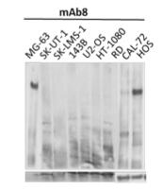
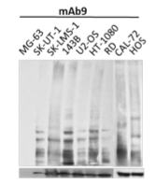
Binding of various purified mAbs to COMP constitutively expressed by different sarcoma cell lines – Western Blotting Reducing conditions

Slide 9
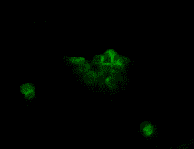
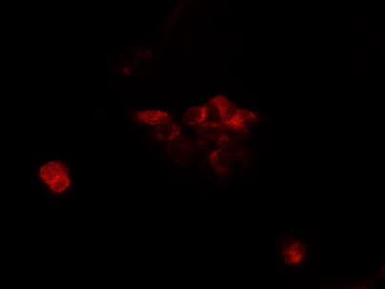
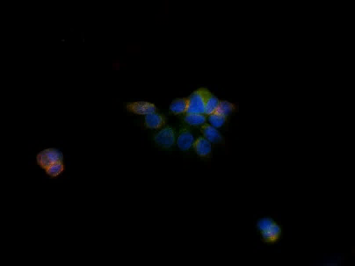
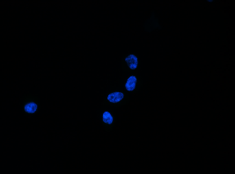
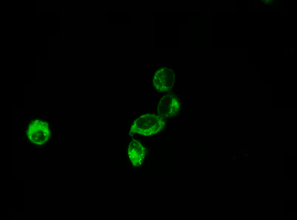
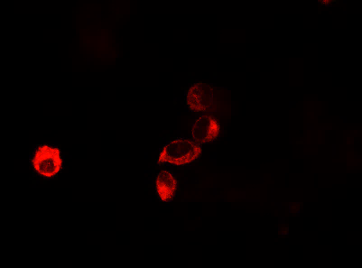
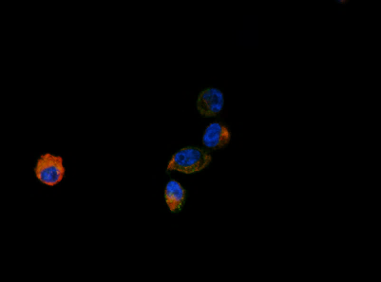
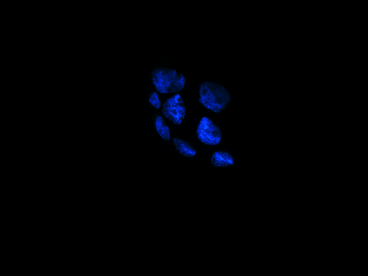
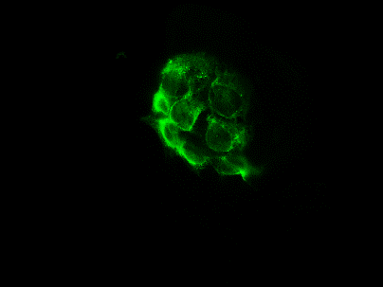
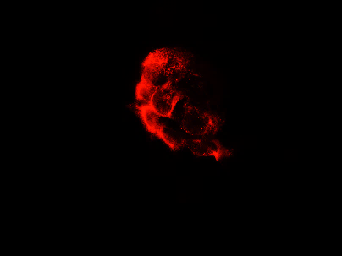
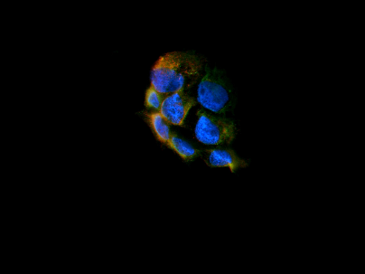
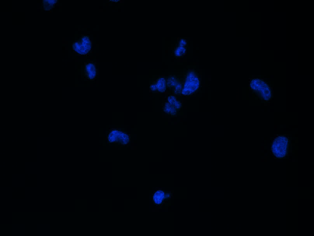
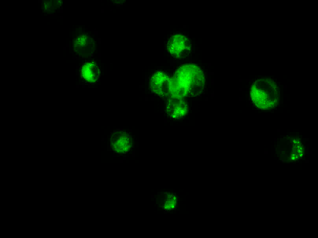
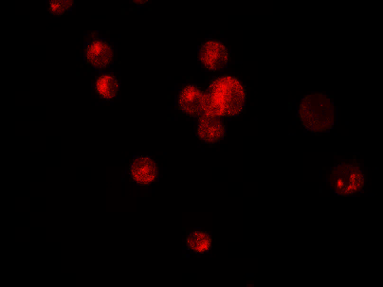
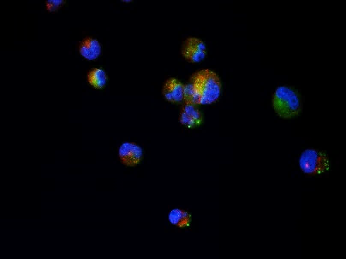
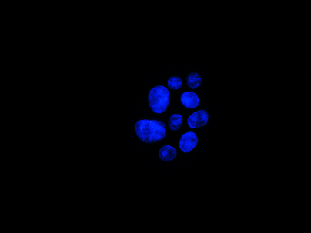
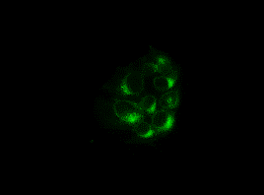
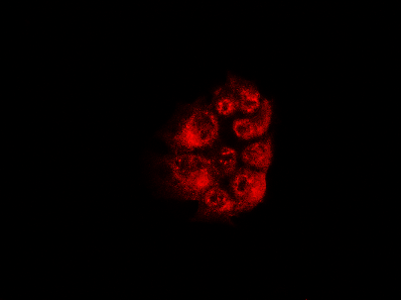
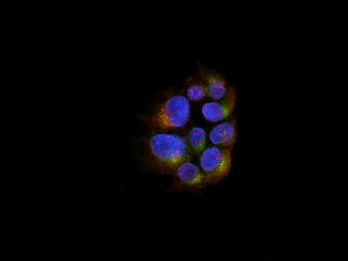
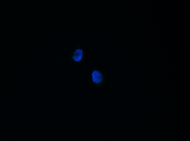
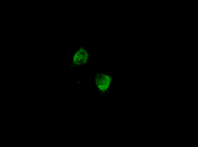
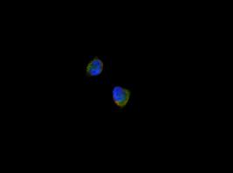
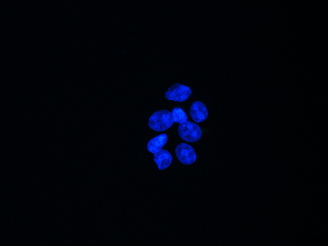
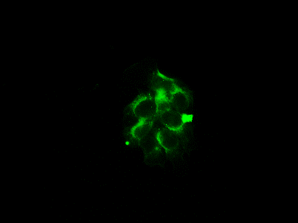
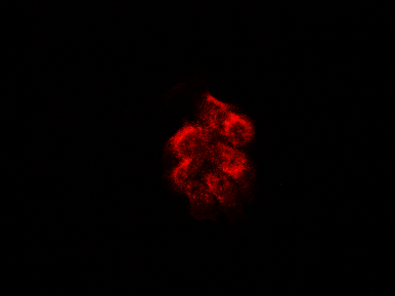
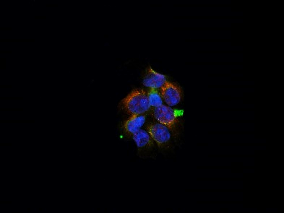
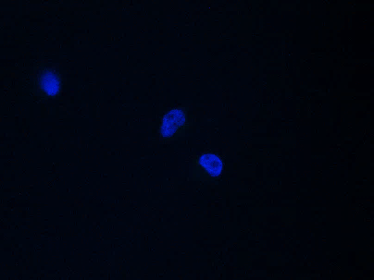
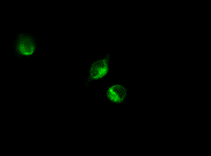
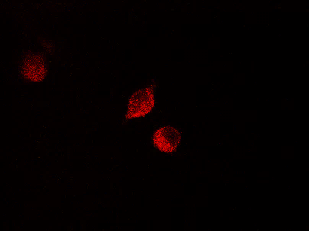
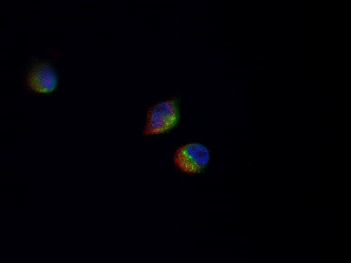
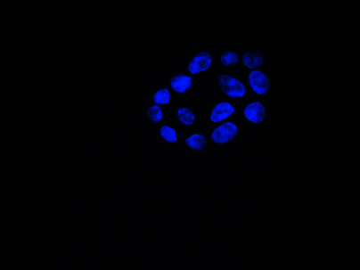
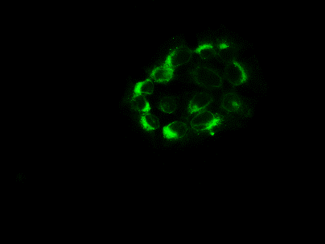
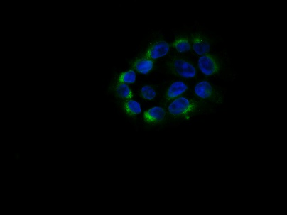
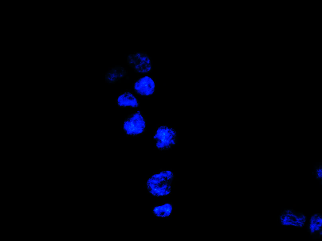
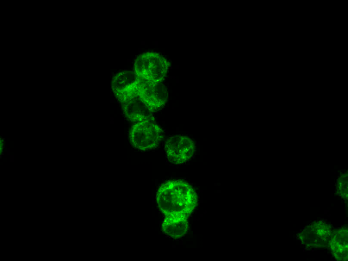
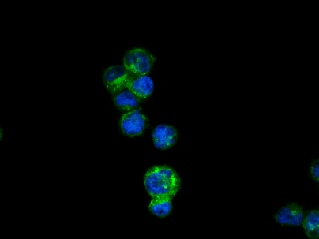
Permeabilised Immunocytochemistry
BT-20
MDA-MB-231
Control Ig
NUCLEI
ER
COMP
MERGE
NUCLEI
ER
COMP
MERGE
mAb 1
mAb 2
mAb 3
Nuclei (Hoest 33258)
ER (Concanavalin A-Alexa 488)
COMP (Alexa 594)
mAb 4
mAb 5
mAb 6
NUCLEI
ER
COMP
MERGE
NUCLEI
ER
COMP
MERGE
mAb 7
mAb 8
mAb 9

Slide 10
Permeabilised (Triton X-100) and non permeabilised Immunocytochemistry in sarcoma cell lines

Slide 11
BT-20
Extracellular cell Flow cytofluorimetry
MDA-MB-231

Slide 12
BT-20
MDA-MB-231
Intracellular cell
Flow cytofluorimetry

Slide 13
Screening sarcoma cells - Extracellular cell Flow cytofluorimetry
Intracellular cell Flow cytofluorimetry of MG-63

Slide 14
Scrath Assay – MDA-MB-231 (COMP and MOCK)

Slide 15
Trypan blue exclusion Assay MDA-MB-231 COMP
CytoTox-Glo™ Assay MDA-MB-231 COMP
Cell Death Assay
Trypan blue exclusion Assay MG-63

Slide 16
Doxorubicin dose-response curve in MDA-MB-231
Combination mAb 6 - Doxorubicin in
MDA-MB-231
Doxorubicin dose-response curve in MG-63
Combination mAb 6 - Doxorubicin in
MG-63

Slide 17
The antibodies tested showed high affinity in recognition and binding to COMP both in its native form (recombinant COMP) and in that expressed by BT-20 and MDA-MB-231 COMP tumor cells.
The sarcoma lines analyzed are positive for constitutive COMP expression, and monoclonal antibodies are able to bind the protein.
mAb 3 and mAb 6 are able to significantly reduce cell migration after 48 hours in the tested breast carcinoma line MDA-MB-231.
The mAb 6 antibody in the MDA-MB-231 line is interesting in inducing cell death when administered at a dose of 300 μg.
Conclusions
Other monoclonal antibodies will be tested as potential therapeutic agents.
Additional cell death induction assays will be performed in combination with additional drugs.
Future prospects

Slide 18
Grazie per l’attenzione

